Slide 1
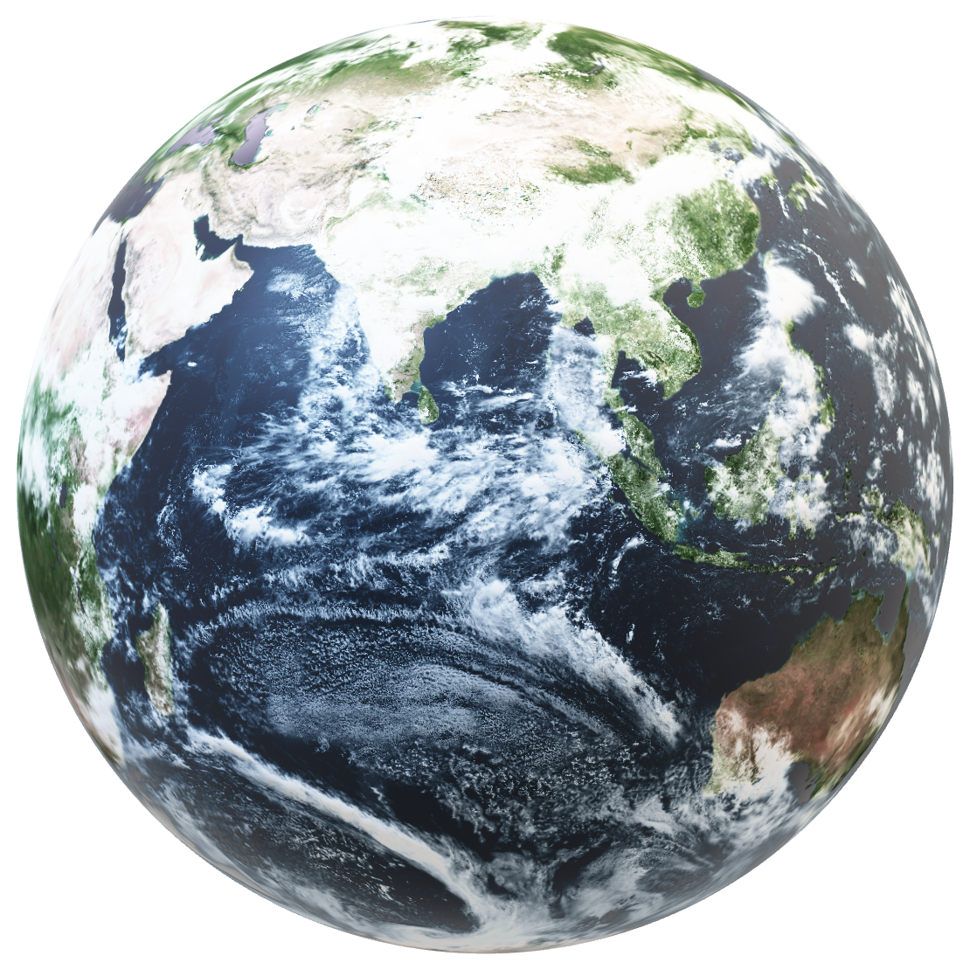

Slide 2
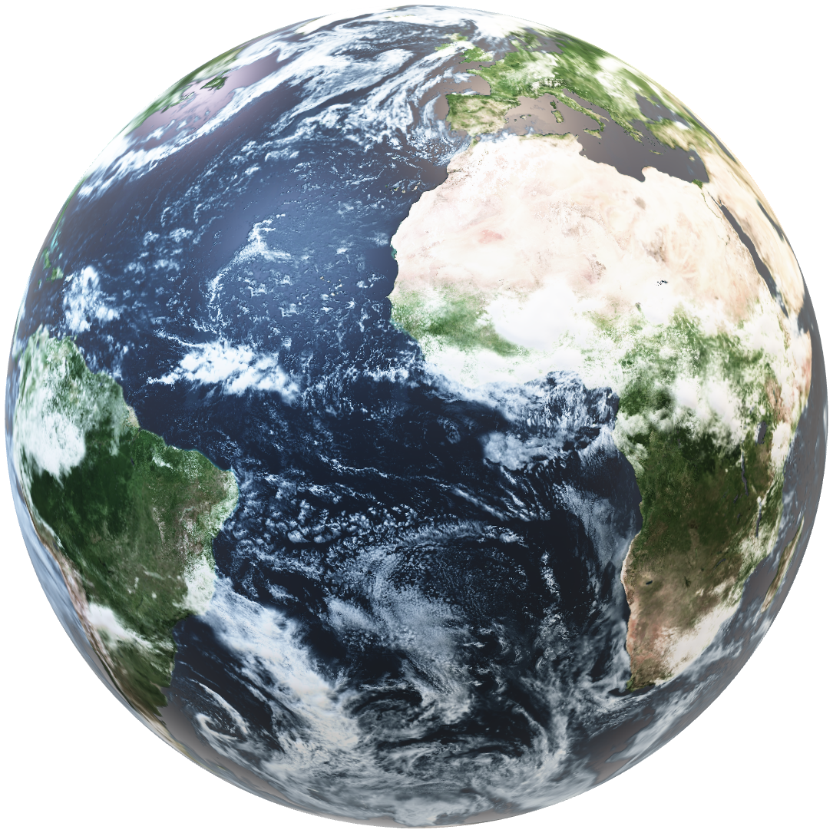
Wate
WATE
WATE

Slide 3
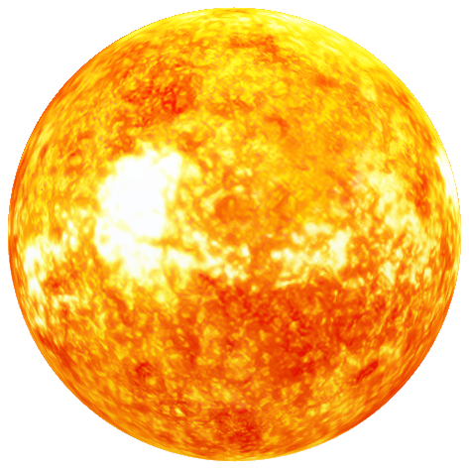
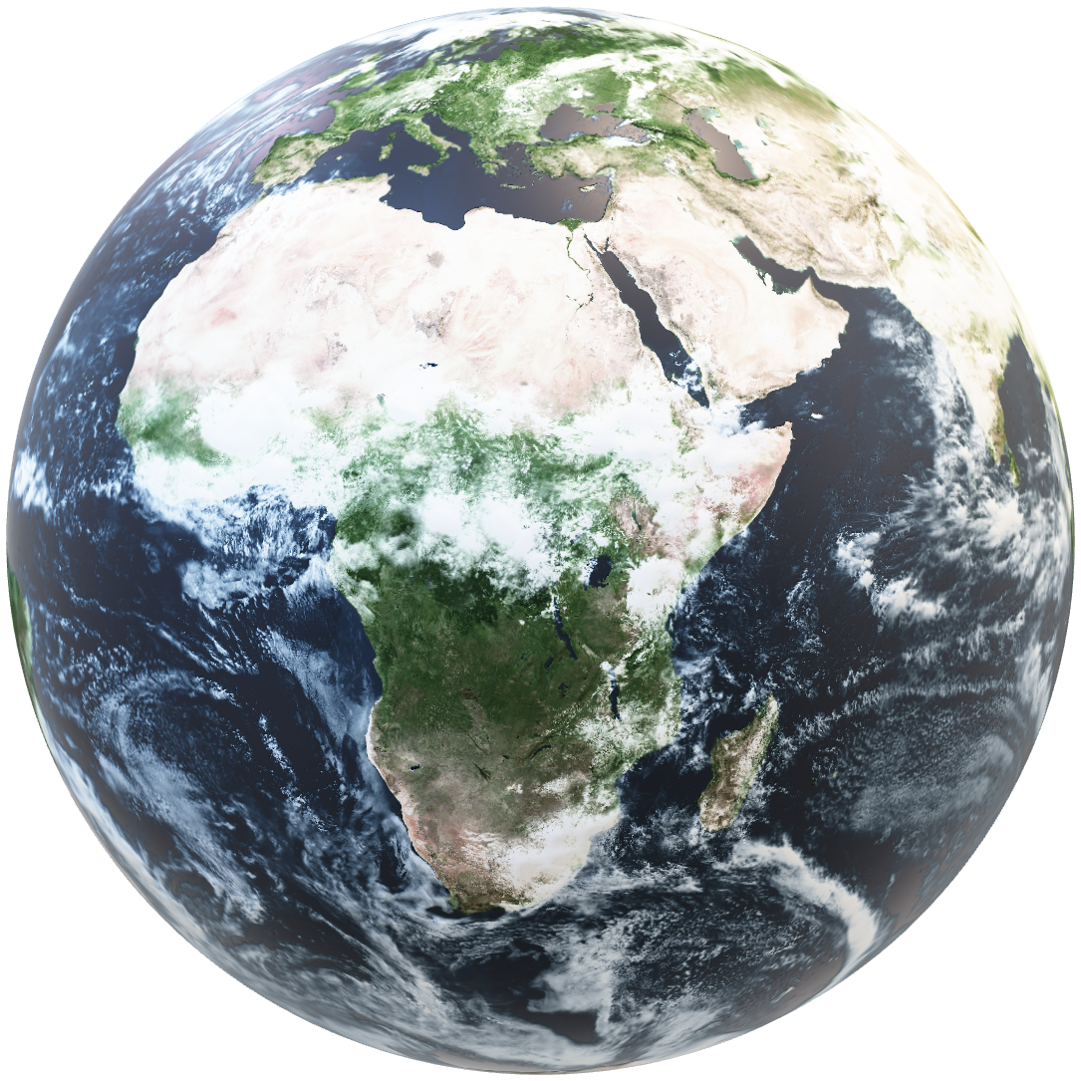
WATE
WATE

Slide 4

Table of contents
The Team
The Task
Technologies
Implement

Slide 5

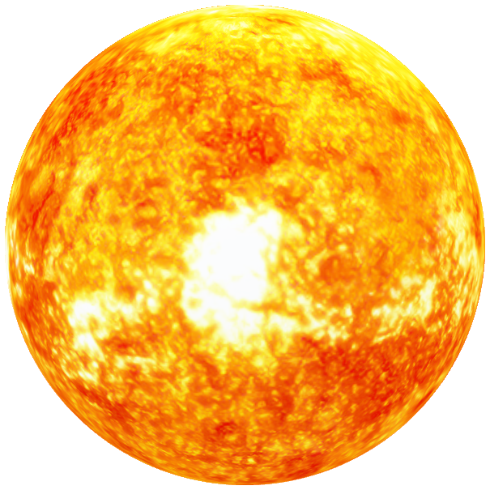
01
let’s meet the team.

Slide 6






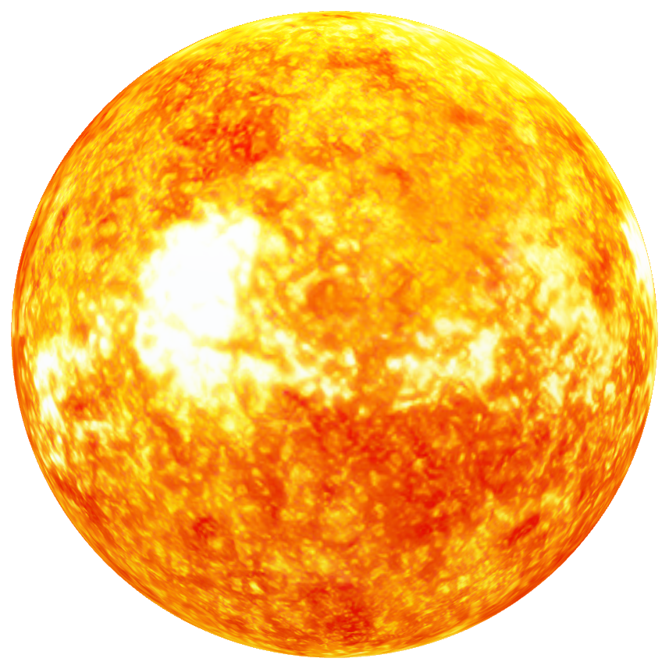
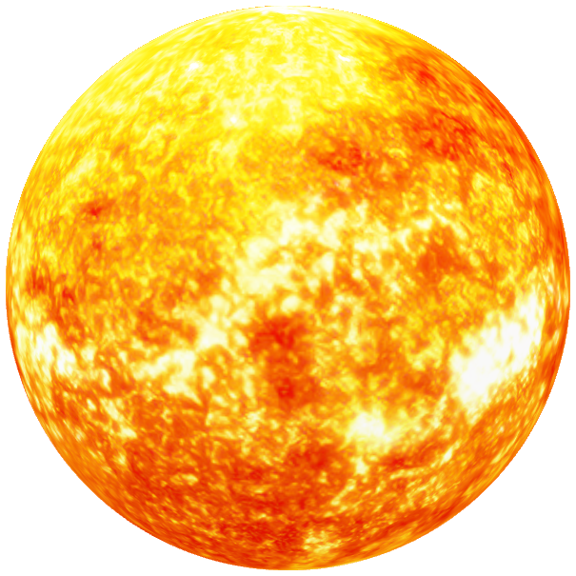
💡

Slide 7
scrum trainer.

Slide 8
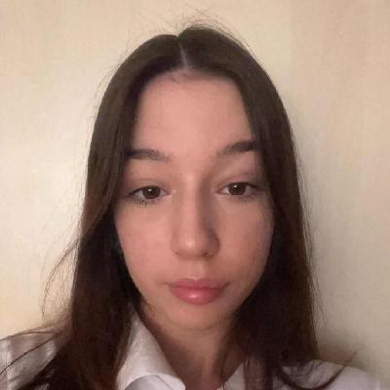
Kalina Atanasova

Slide 9
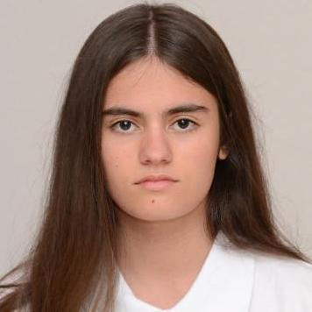
Iva Raikova

Slide 10
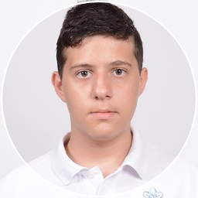
Kaloqn Iliev

Slide 11
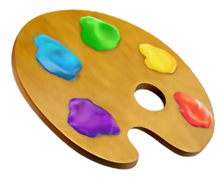
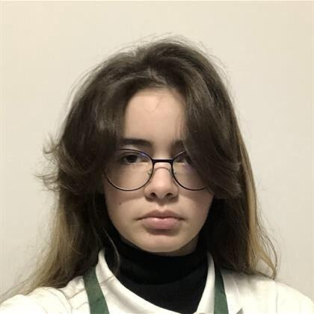
Natali Ribareva

Slide 12
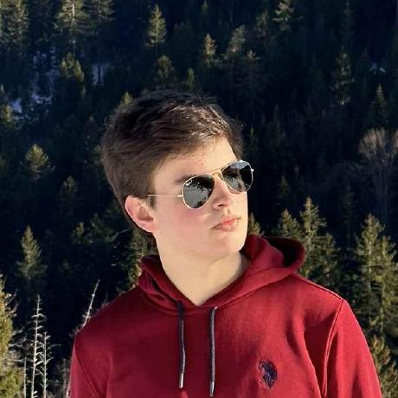
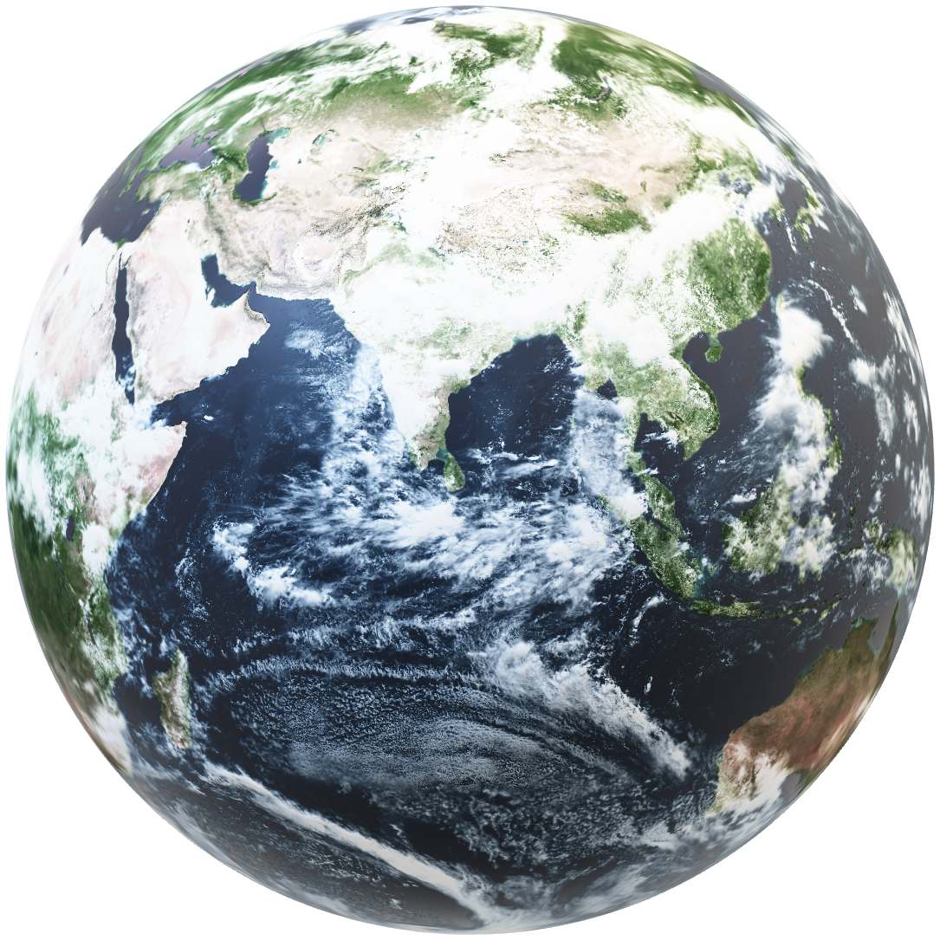
Valeri Ivanov

Slide 13
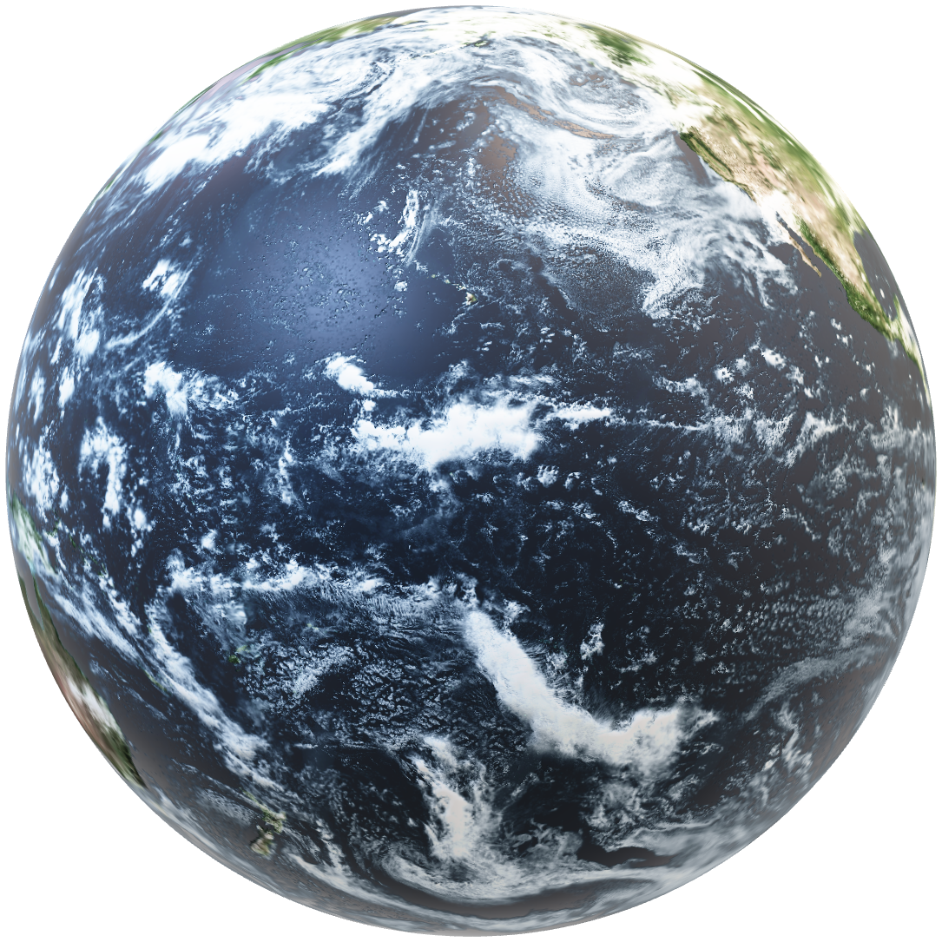

THE TASK

Slide 14
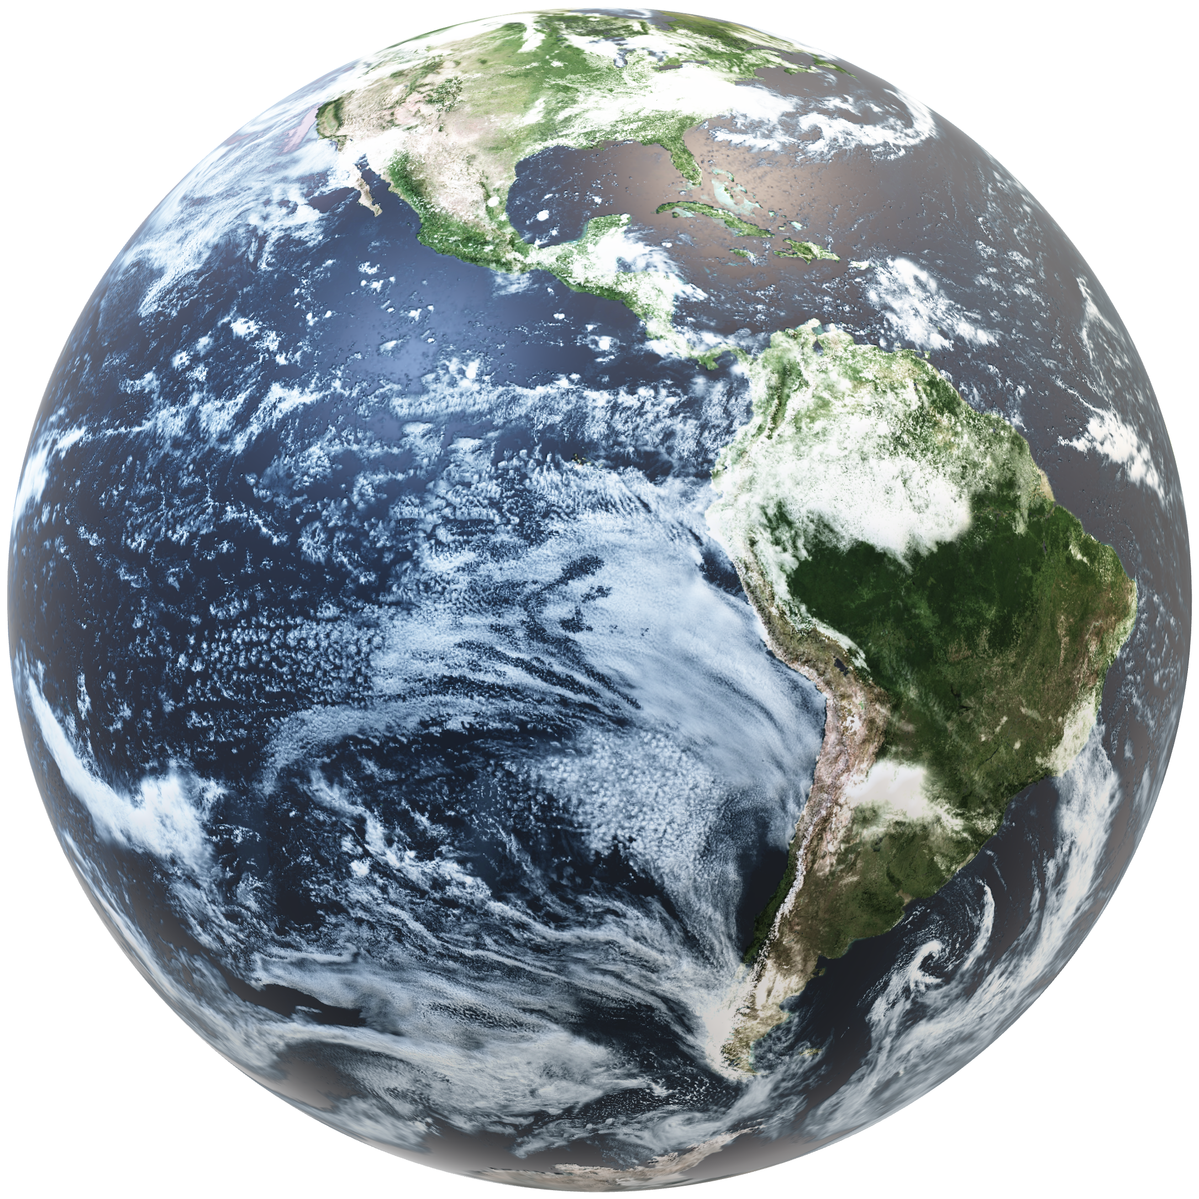

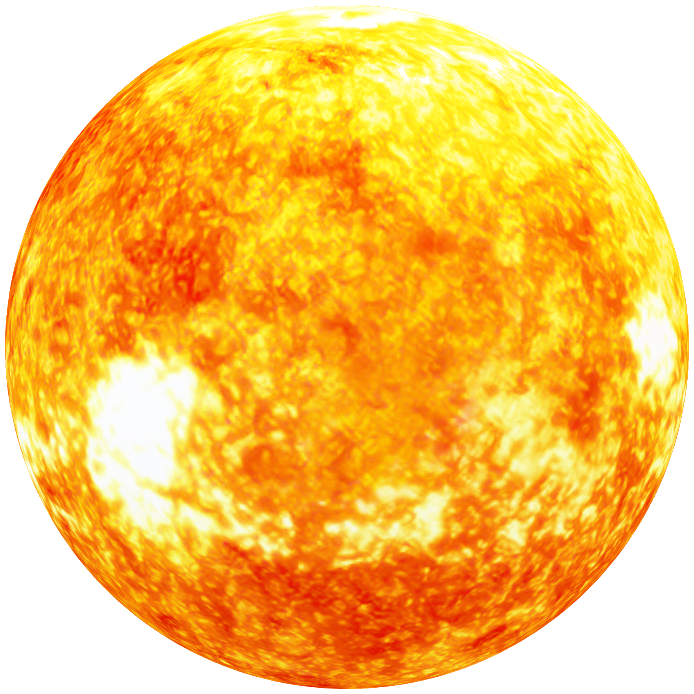
THE TASK
To provide information about innovative solutions to continental problems, as well as to communicate the problem of global warming.
What’s unique is that we have a game that allows you to plant trees, in return you get virtual coins and by doing this we show our users that caring for nature should be done by us, the people.

Slide 15
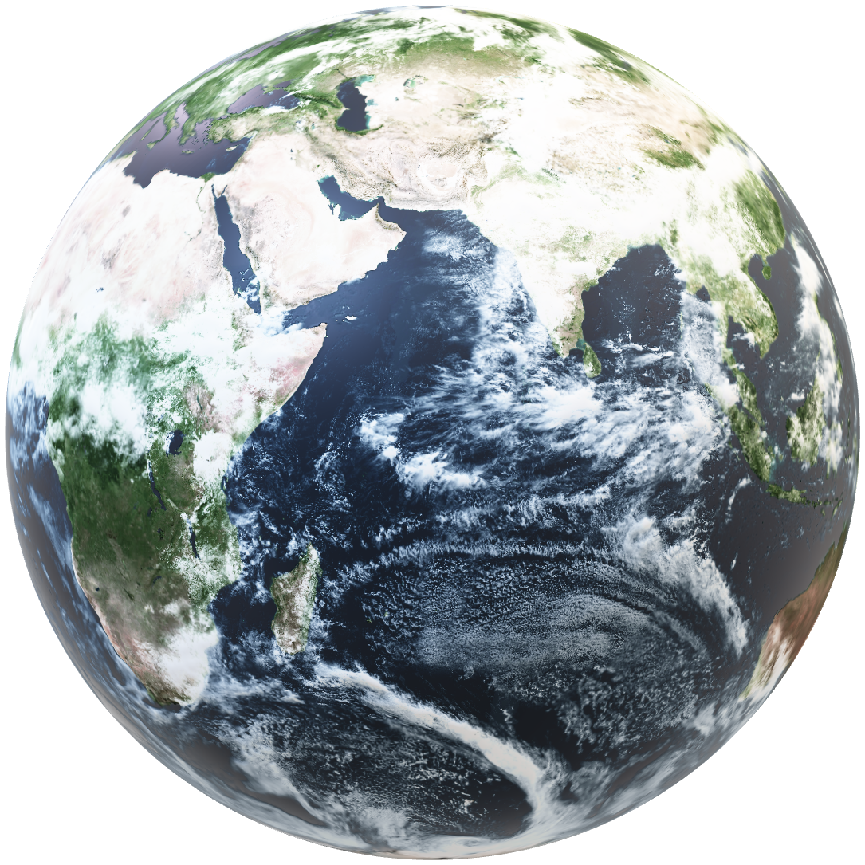

TECHNOLOGIES

Slide 16






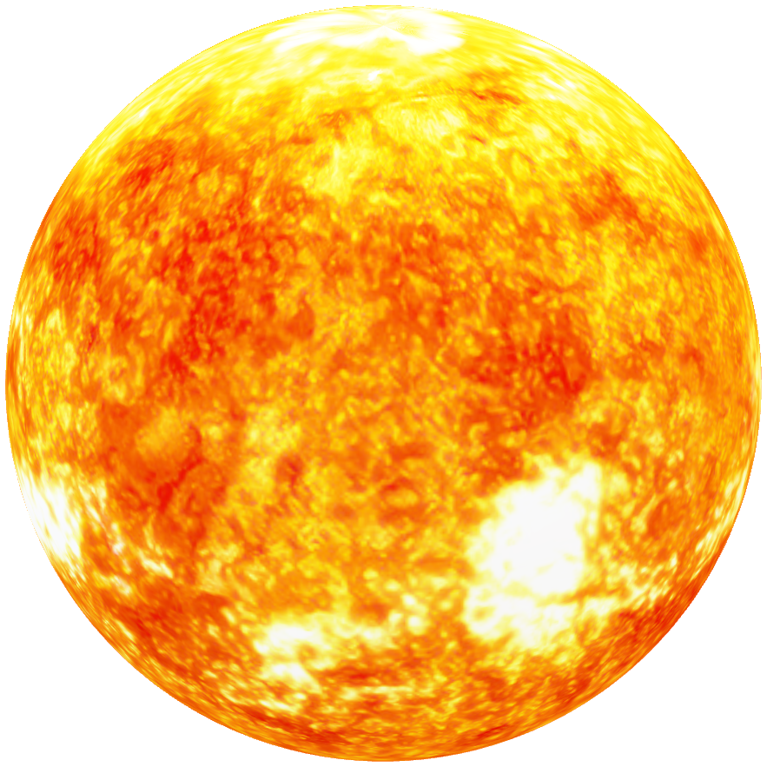

Slide 17






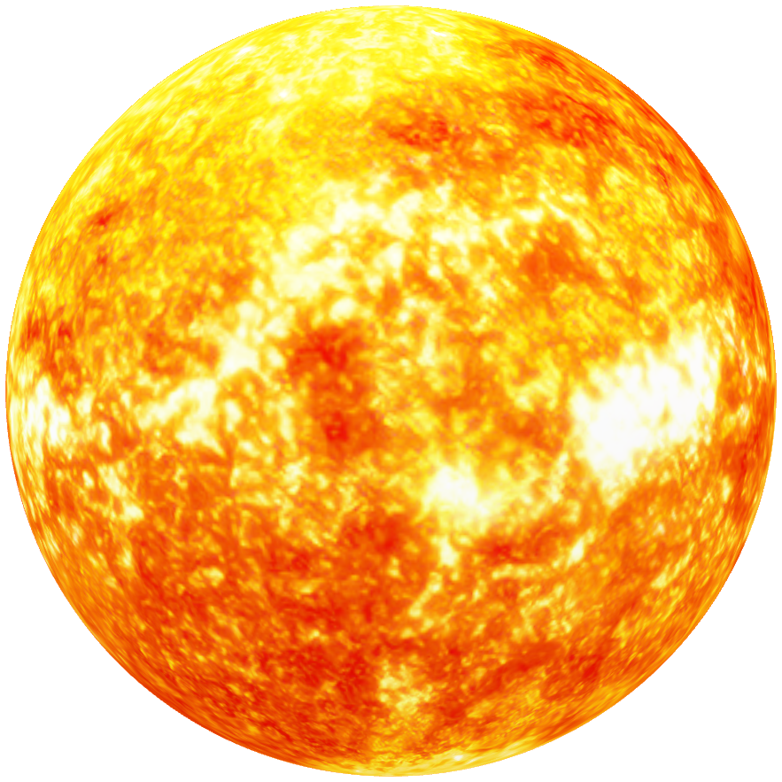
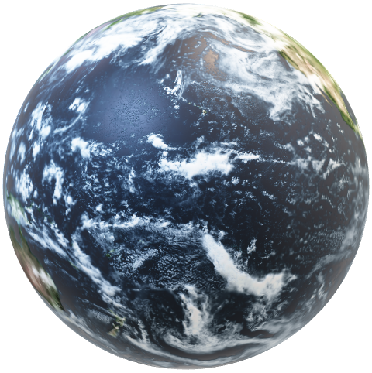

Slide 18
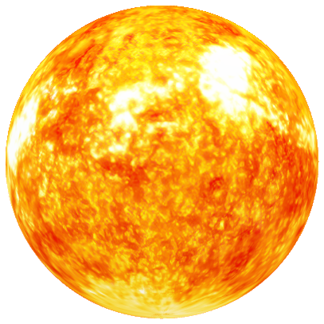
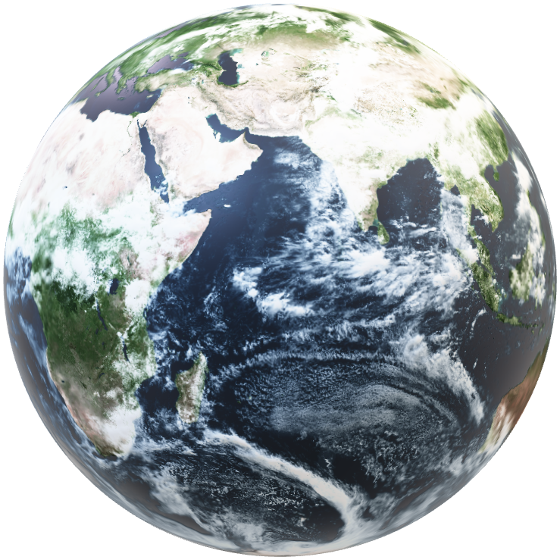
Implement
Implement

Slide 19

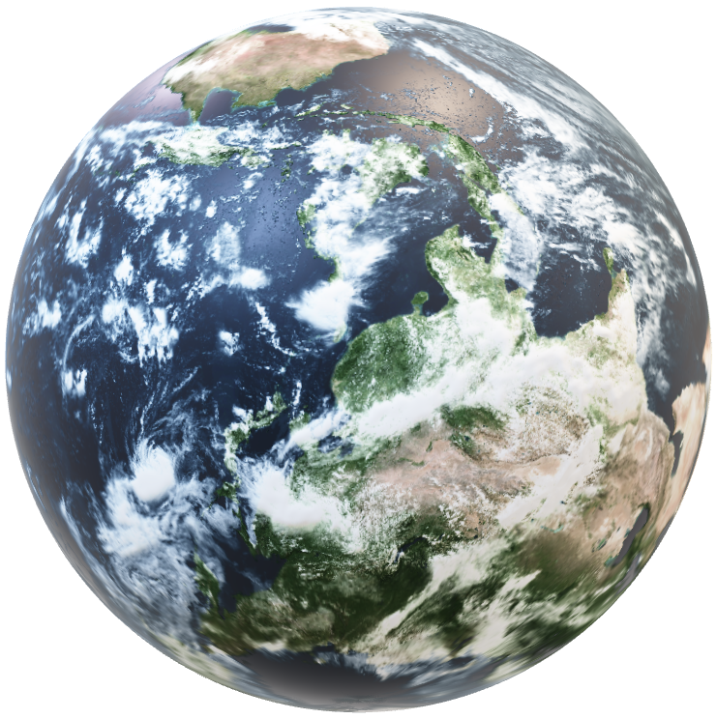
Implement
Implement
Wate took on the ambitious task of constructing our platform ,demonstrating adaptability and unwavering commitment. Our mission is to share innovative solutions to continental problems and uniquely engaging users through a game that incentivizes virtual tree planting, reinforcing the idea that environmental responsibility is a collective effort.

Slide 20
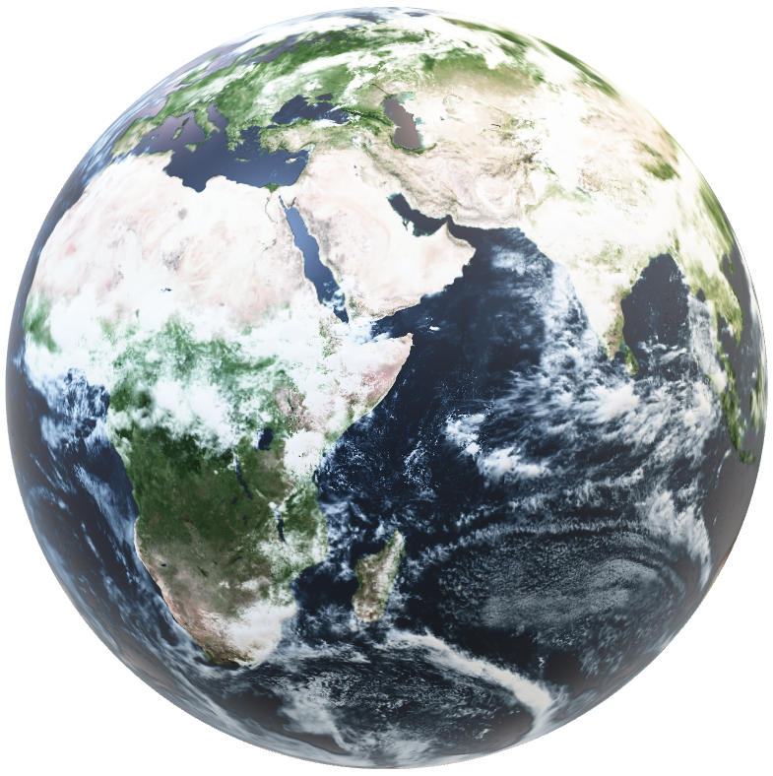
Let’s take a look at our project.

Slide 21
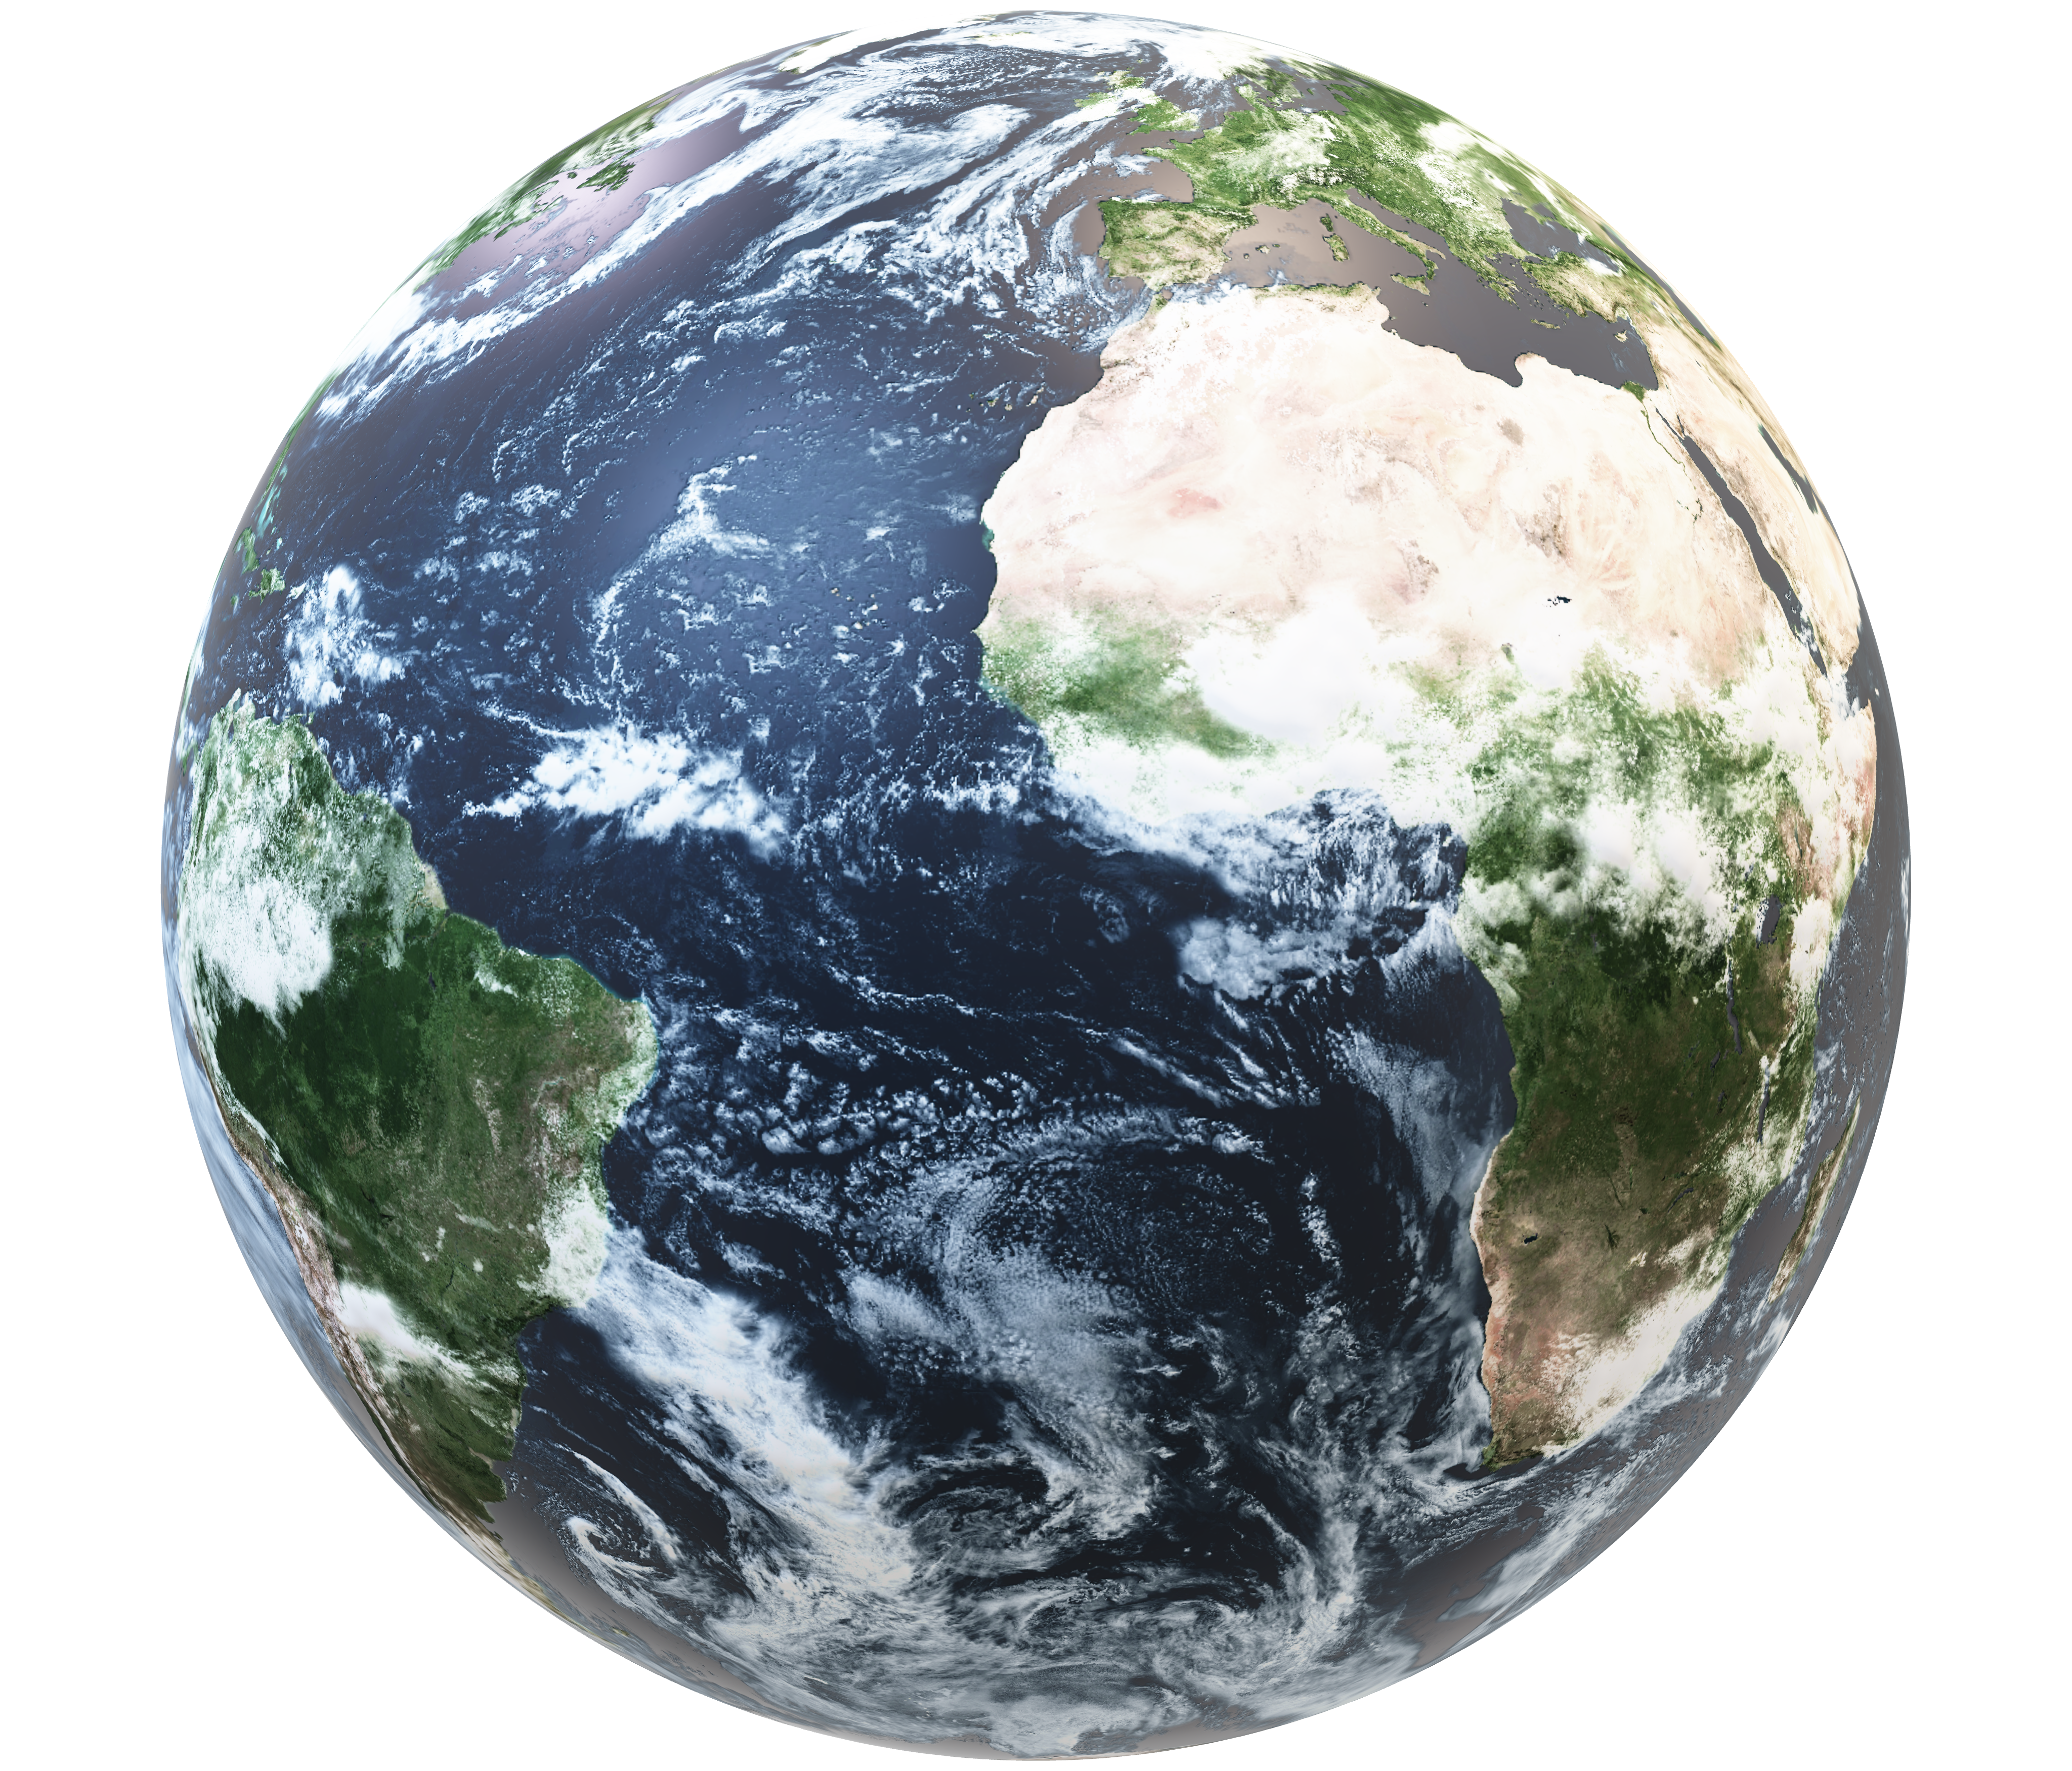
WATE
WATE

